Slide 1

Amazon Sales Data Analysis
Low Level Design (LLD)

Slide 2
Document Version Control:
Date Issued | Version | Description | Author
28/01/23 | 1.0 | Final Version of Complete LLD | Himanshu Pewal

Slide 3
ABSTRACT:
Amazon Sales Management is looking for improved methods to increase sales and profits. The management has asked to create sales report on Yearly, Monthly Sales Trend to understand the market behavior. They’re looking for relationships between different variables that directly affect sales
Amazon Sales Management is looking for improved methods to increase sales and profits. The management has asked to create sales report on Yearly, Monthly Sales Trend to understand the market behavior. They’re looking for relationships between different variables that directly affect sales

Slide 4
1 INTRODUCTION:
Why this Low-Level Design Document?
1.1What is Low-Level design document? The goal of the LDD or Low-level design document (LLDD) is to give the internal logic design of the report for the Amazon Sales Data Analysis. LDD describes the procedures and relationships between the variables and programs data visualizations.

Slide 5
SCOPE:
Low-level design (LLD) is a component-level design process that follows a step-by-step refinement process. The process can be used for designing reports, dashboards and required charts to showcase relationship between different data points.

Slide 6
3. Architecture Description
3.1.Data Description
The Dataset contains Amazon Sales Data consists of columns like Sales Amount, Sales Quantity, Margin Amount, Sales Cost, Items, Item Orders, Sales Representatives, Item Class and Date of Order.
Discount Amount: Discount on every ordered item.
Date: Ordered Date.
Item: Name of the item ordered.
List Price: The price at which the item is listed.
Sales Amount: Total amount of sales for particular item.
Sales Cost Amount: Amount spent for conversion of Sale.
Sales Margin Amount: Margin amount on each item sold.
Sales Quantity: Total number of items sold
Sales Representative: Representative under whom sale is completed

Slide 7
3.2.Data Cleaning:
Data Cleaning is a crucial stage before we start creating visuals. The dataset given some time has impurities such as missing values or incorrect data types. Data cleaning can be performed in Python with Pandas library to remove missing values and make dataset ready for building visuals.
3.3.Data Importing:
In Tableau we have options to connect to our dataset via various options such as SQL Server, MYSQL, excel or CSV files. We have our clean data in CSV file. We will import it in Power BI with import data option and start working with it.

Slide 8
GENERAL DESCRIPTION:
2.1 Business Perspective & Problem Statement
Amazon is a global e-commerce brand establishing businesses across the world. The stakeholders are looking to understand market behavior and sales trend to gain a competitive advantage.
The objective of the project is to create a report on Sales trend year-wise, month-wise to understand the factors directly affecting the sales. This project aims apply Business Intelligence tool such as Power BI to get a visual understanding the sales data.

Slide 9





TOOLS USED:
Programming Language: Python
Python Libraries: NumPy, Pandas
Business Intelligence Tools: Excel, Tableau

Slide 10
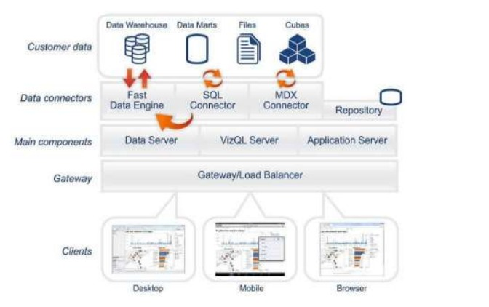
Design Details:
Figure 1: Functional Architecture of Business Intelligence

Slide 11
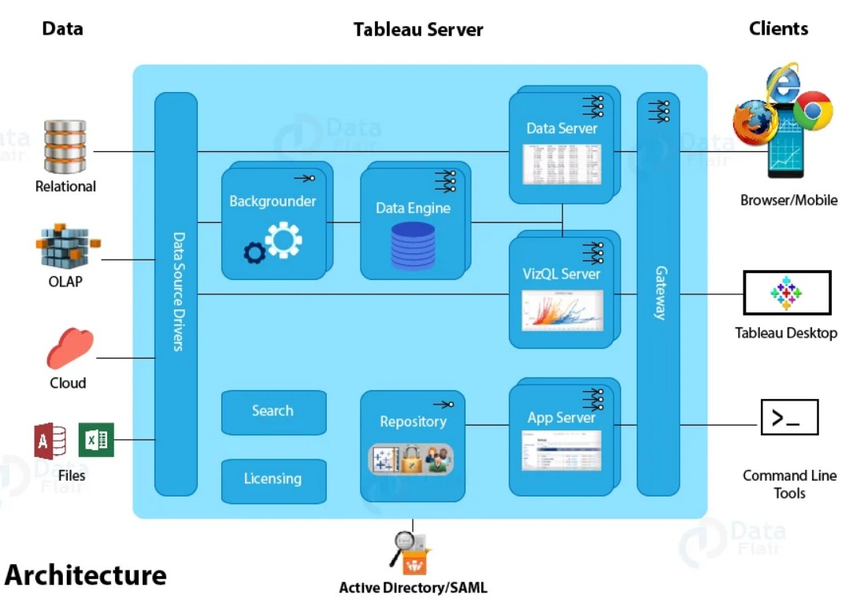
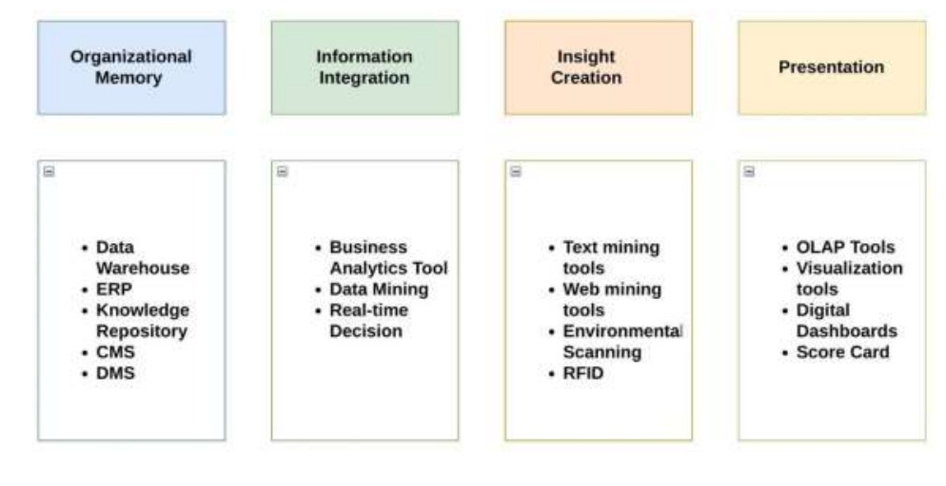
HOW TABLEAU WORKS:
Tableau has a highly scalable architecture that serves mobile clients, web clients and desktop installed software. Tableau architecture supports fast and flexible report and dashboard creation to drive business insights.

Slide 12
UNIT TEST CASES:
DESCRIPTION | EXPECTED REDULTS
Year slicer | When clicked on the slicer, the shows results for that particular year
Month Slicer | When clicked on the slicer, a dropdown occurs which lists the name of months. This helps us see data by each month.
Monthly Trend for Sales | This chart showcases trend for monthly sales. Top performing months and low performing months can be easily segmented.
Yearly Trend for Sales | This chart displays which year has been best one so far in regards to the sales.
Relation between Sales Amount and Discount Amount | The visual shows a line chart displaying relation between Sales Amount and Discount
Top 10 ordered items. | This is a table that displays top 10 items that were ordered frequently. It also shows list price and sales price to understand the reasoning behind higher orders.
Top Sales Representatives | This chart shows top performing sales representatives with the sales amount.
Relationship between Sales Cost and Total Sales | A scatterplot that helps us understand relationship between sales cost and total sales.
Relationship between Sales Quantity and List Price | This visual has a scatterplot that helps us understand relationship between sales quantity and list price.
Relationship between Sales Price and List Price | A scatterplot chart helps us understand relationship between sales price and list price.
Top Margin Items | This chart displays higher margin items.

Slide 13
DEPLOYMENT:
Prioritizing data and analytics couldn’t come at a better time. Your company, no matter what size, is already collecting data and most likely analyzing just a portion of it to solve business problems, gain competitive advantages, and drive enterprise transformation. With the explosive growth of enterprise data, database technologies, and the high demand for analytical skills, today’s most effective IT organizations have shifted their focus to enabling self-service by deploying and operating Tableau at scale, as well as organizing, orchestrating, and unifying disparate sources of data for business users and experts alike to author and consume content.

